Slide 1
Apache Kafka

Slide 2
Installation and Setup
Install Java 8
Download Kafka (kafka.apache.org/downloads) – kafka_2.13-3.1.0.tgz
Extract: c:\kafka_2.13-3.1.0
Add c:\kafka_2.13-3.1.0\bin\windows to PATH variable
Create data folder under kafka and zookeeper and kafka under data, i.e. c:\kafka_2.13-3.1.0\data\zookeeper and c:\kafka_2.13-3.1.0\data\kafka
Edit c:\kafka_2.13-3.1.0\config\zookeeper.properties to have dataDir=c:\\kafka_2.13-3.1.0\\data\\zookeeper
Try starting zookeeper: c:\kafka_2.13-3.1.0\bin\windows>zookeeper-server-start.bat c:\kafka_2.13-3.1.0\config\zookeeper.properties

Slide 3
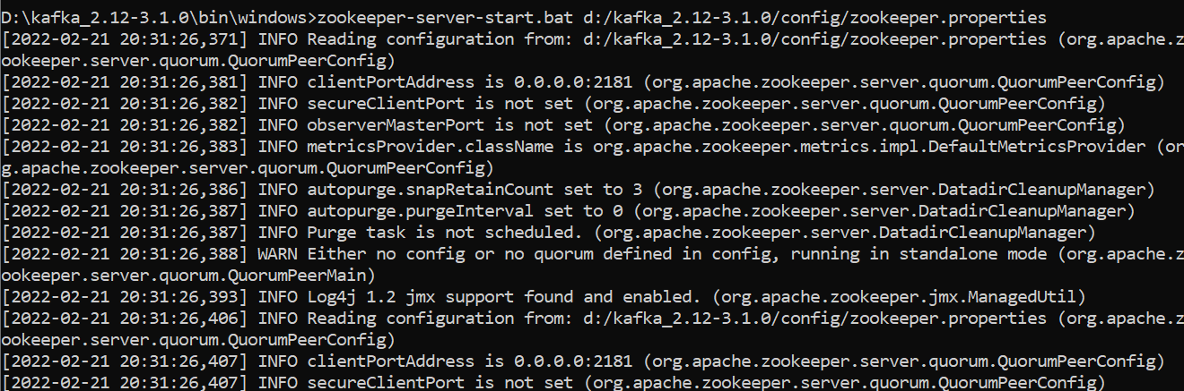
Test Zookeeper
c:\kafka_2.13-3.1.0\bin\windows>zookeeper-server-start.bat C:\kafka_2.13-3.1.0\config\zookeeper.properties

Slide 4
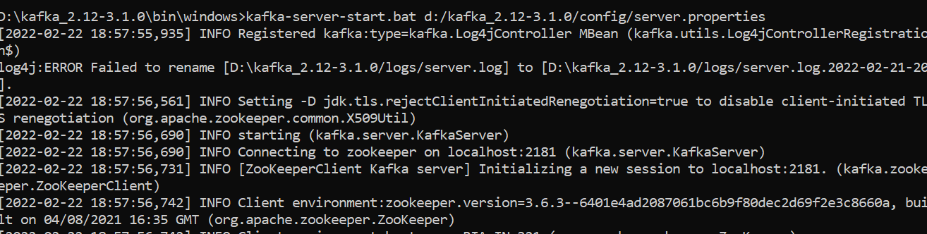
Edit server.properties file (In config directory)
log.dirs=c:\\kafka_2.13-3.1.0\\data\\kafka
Then start kafka:
c:\kafka_2.13-3.1.0\bin\windows>kafka-server-start.bat c:/kafka_2.13-3.1.0/config/server.properties (If it fails to start, try restarting zookeeper and then retry starting the kafka server)

Slide 5
Using Kafka CLI

Slide 6
Using Kafka CLI
Creating a topic: Open a new command prompt and try the following command
c:\kafka_2.13-3.1.0\bin\windows>kafka-topics --create --topic first_topic --bootstrap-server localhost:9092

Slide 7
Verify topic creation
D:\kafka_2.12-3.1.0\bin\windows>kafka-topics --list --bootstrap-server localhost:9092
Get more information: D:\kafka_2.12-3.1.0\bin\windows>kafka-topics --topic first_topic --describe --bootstrap-server localhost:9092

Slide 8
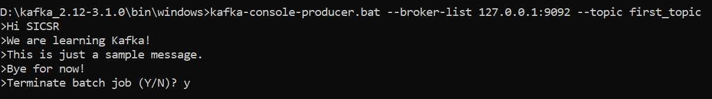
Writing to the first topic
D:\kafka_2.12-3.1.0\bin\windows>kafka-console-producer.bat --broker-list 127.0.0.1:9092 --topic first_topic
(Press Ctrl+C after line 4)

Slide 9
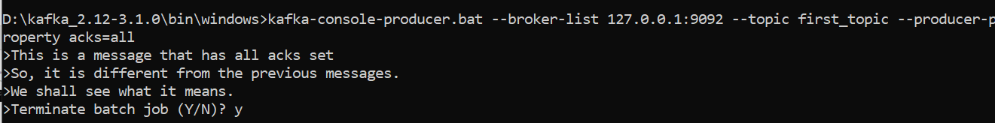
Message with all acks set
D:\kafka_2.12-3.1.0\bin\windows>kafka-console-producer.bat --broker-list 127.0.0.1:9092 --topic first_topic --producer-property acks=all

Slide 10
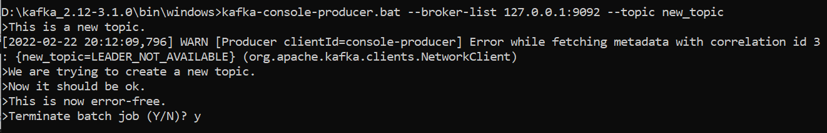
Trying to create a new topic
D:\kafka_2.12-3.1.0\bin\windows>kafka-console-producer.bat --broker-list 127.0.0.1:9092 --topic new_topic
After the first message, there was a warning; but then it recovered automatically

Slide 11
Once again check topics
D:\kafka_2.12-3.1.0\bin\windows>kafka-topics --list --bootstrap-server localhost:9092
Let us describe it
D:\kafka_2.12-3.1.0\bin\windows>kafka-topics --topic new_topic --describe --bootstrap-server localhost:9092

Slide 12

Increase the default partition count
Edit server.properties
Change default number of partitions to 3
To test, stop Kafka server (Ctrl+C) and restart it
Create a new topic and describe it – Next slide

Slide 13
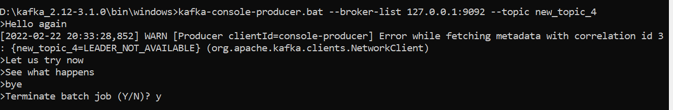
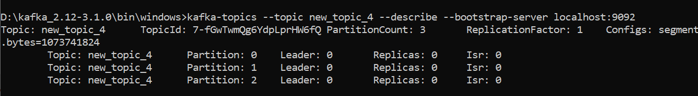
Increase the default partition count
Create a new topic
D:\kafka_2.12-3.1.0\bin\windows>kafka-console-producer.bat --broker-list 127.0.0.1:9092 --topic new_topic_4
Describe it

Slide 14
Kafka console consumer CLI
Let us try consuming the contents of an earlier topic
D:\kafka_2.12-3.1.0\bin\windows>kafka-console-consumer --topic first_topic --bootstrap-server localhost:9092
Nothing appears! This is because only new messages will be shown
So, open another command prompt and add a new message to first_topic
See next slide

Slide 15
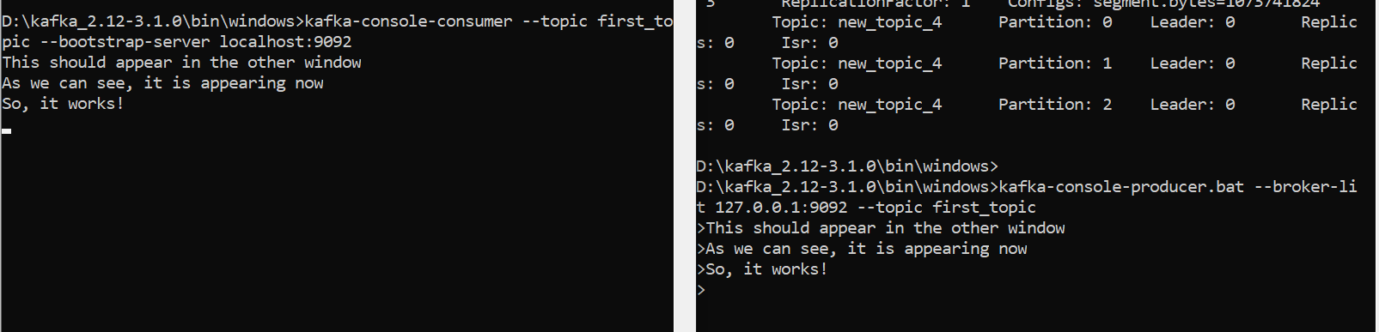
Kafka console consumer CLI

Slide 16
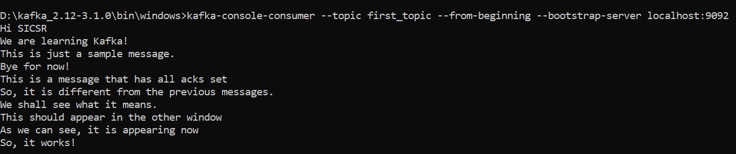
See all the messages in a topic

Slide 17
Kafka Java Programming

Slide 18
Setup
Create directory D:\code\kafka\kafkatest
Open command prompt in the above and type gradle init
In the build.gradle file, we will need to add Kafka dependencies
So google kafka maven and look for kafka-clients at https://mvnrepository.com/artifact/org.apache.kafka
In kafka-clients, click on 2.0, then gradle, and copy-paste the dependency in build.gradle file
In maven repository site, search for slf4j simple and click on slf4j-simple, select 1.7.30, copy-paste gradle code into build.gradle file
See next slide

Slide 19
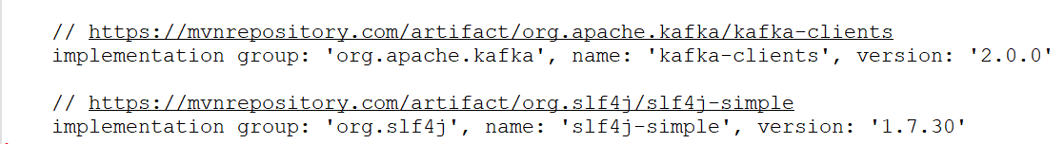
build.gradle file (D:\code\kafka\kafkatest\app)

Slide 20
Code D:\code\kafka\kafkatest\app\src\main\java\com\sicsr\mykafka\ProducerDemo.java
package com.sicsr.mykafka;
public class ProducerDemo {
public static void main (String [] args) {
System.out.println ("Hello World");
}
}

Slide 21
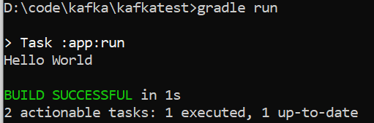
Build and test
D:\code\kafka\kafkatest>gradle tasks –all
D:\code\kafka\kafkatest>gradle compileJava
D:\code\kafka\kafkatest>gradle run

Slide 22
Modify producer code
package com.sicsr.mykafka;
import java.util.Properties;
public class ProducerDemo {
public static void main (String [] args) {
// create Producer properties
Properties properties = new Properties ();
// create the producer
// send data
}
}
What properties to add? Next slide

Slide 23
Modify producer code
Go to Apache Kafka
Scroll down to Producer Configs and click for API details just for understanding
Now we will write the producer code (Next slide)

Slide 24
Modified producer code
package com.sicsr.mykafka;
import org.apache.kafka.clients.producer.KafkaProducer;
import org.apache.kafka.clients.producer.ProducerConfig;
import org.apache.kafka.clients.producer.ProducerRecord;
import org.apache.kafka.common.serialization.StringSerializer;
import java.util.Properties;
public class ProducerDemo {
public static void main (String [] args) {
String bootstrapServers = "127.0.0.1:9092";
// create Producer properties
Properties properties = new Properties ();
properties.setProperty (ProducerConfig.BOOTSTRAP_SERVERS_CONFIG, bootstrapServers);
properties.setProperty (ProducerConfig.KEY_SERIALIZER_CLASS_CONFIG, StringSerializer.class.getName ());
properties.setProperty (ProducerConfig.VALUE_SERIALIZER_CLASS_CONFIG, StringSerializer.class.getName ());
// create the producer
KafkaProducer <String, String> producer = new KafkaProducer <String, String> (properties);
// Create a producer record
ProducerRecord <String, String> record = new ProducerRecord <String, String> ("first_topic", "Testing Kafka");
// send data
producer.send (record);
}
}

Slide 25
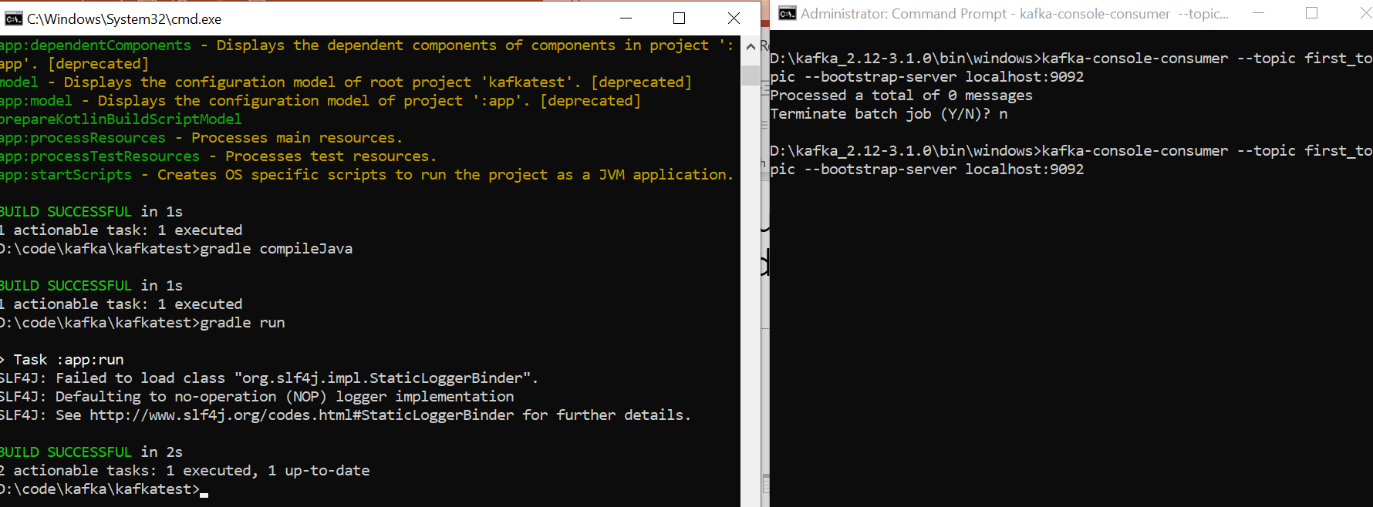
Try running the consumer in a window, and compile and run producer code in another: Nothing happens!

Slide 26
Flush and close producer – Modified code
package com.sicsr.mykafka;
import org.apache.kafka.clients.producer.KafkaProducer;
import org.apache.kafka.clients.producer.ProducerConfig;
import org.apache.kafka.clients.producer.ProducerRecord;
import org.apache.kafka.common.serialization.StringSerializer;
import java.util.Properties;
public class ProducerDemo {
public static void main (String [] args) {
String bootstrapServers = "127.0.0.1:9092";
// create Producer properties
Properties properties = new Properties ();
properties.setProperty (ProducerConfig.BOOTSTRAP_SERVERS_CONFIG, bootstrapServers);
properties.setProperty (ProducerConfig.KEY_SERIALIZER_CLASS_CONFIG, StringSerializer.class.getName ());
properties.setProperty (ProducerConfig.VALUE_SERIALIZER_CLASS_CONFIG, StringSerializer.class.getName ());
// create the producer
KafkaProducer <String, String> producer = new KafkaProducer <String, String> (properties);
// Create a producer record
ProducerRecord <String, String> record = new ProducerRecord <String, String> ("first_topic", "Testing Kafka");
// send data
producer.send (record);
// flush data
producer.flush ();
producer.close ();
}
}

Slide 27
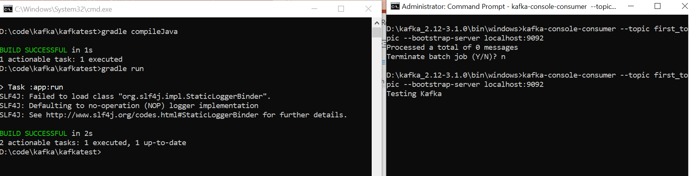
Retest

Slide 28
Using callbacks: ProducerDemoWithCallback.java
package com.sicsr.mykafka;
import org.apache.kafka.clients.producer.*;
import org.apache.kafka.common.serialization.StringSerializer;
import org.slf4j.Logger;
import org.slf4j.LoggerFactory;
import java.util.Properties;
public class ProducerDemoWithCallback {
public static void main (String [] args) {
Logger logger = LoggerFactory.getLogger (ProducerDemoWithCallback.class);
String bootstrapServers = "127.0.0.1:9092";
// create Producer properties
Properties properties = new Properties ();
properties.setProperty (ProducerConfig.BOOTSTRAP_SERVERS_CONFIG, bootstrapServers);
properties.setProperty (ProducerConfig.KEY_SERIALIZER_CLASS_CONFIG, StringSerializer.class.getName ());
properties.setProperty (ProducerConfig.VALUE_SERIALIZER_CLASS_CONFIG, StringSerializer.class.getName ());
// create the producer
KafkaProducer <String, String> producer = new KafkaProducer <String, String> (properties);
// Create a producer record
ProducerRecord <String, String> record = new ProducerRecord <String, String> ("first_topic", "Hello world");
// send data
producer.send (record, new Callback () {
// Executes every time a message is successfully sent or an exception arises
public void onCompletion (RecordMetadata recordMetadata, Exception e) {
if (e == null) {
logger.info ("Received new metadata. \n" +
"Topic: " + recordMetadata.topic () + "\n" +
"Partition: " + recordMetadata.partition () + "\n" +
"Offset: " + recordMetadata.offset () + "\n" +
"Timestamp: " + recordMetadata.timestamp ());
}
else {
logger.error ("Error while producing ... ", e);
}
}
});
// flush data
producer.flush ();
producer.close ();
}
}

Slide 29
Change in build.gradle
application {
// Define the main class for the application.
mainClass = 'com.sicsr.mykafka.ProducerDemoWithCallback'
}

Slide 30
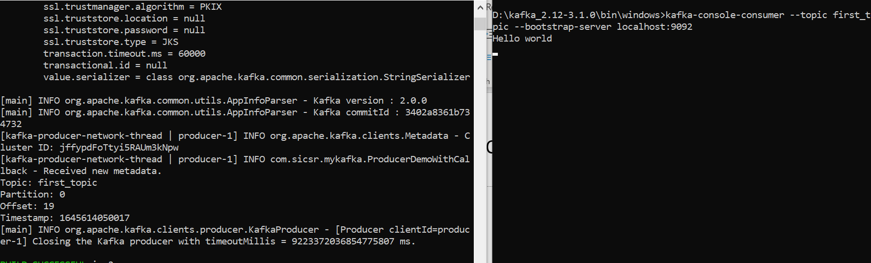
Recompile and execute

Slide 31
Producer with keys: ProducerDemoKeys.java
package com.sicsr.mykafka;
import org.apache.kafka.clients.producer.*;
import org.apache.kafka.common.serialization.StringSerializer;
import org.slf4j.Logger;
import org.slf4j.LoggerFactory;
import java.util.Properties;
public class ProducerDemoKeys {
public static void main (String [] args) {
Logger logger = LoggerFactory.getLogger (ProducerDemoKeys.class);
String bootstrapServers = "127.0.0.1:9092";
// create Producer properties
Properties properties = new Properties ();
properties.setProperty (ProducerConfig.BOOTSTRAP_SERVERS_CONFIG, bootstrapServers);
properties.setProperty (ProducerConfig.KEY_SERIALIZER_CLASS_CONFIG, StringSerializer.class.getName ());
properties.setProperty (ProducerConfig.VALUE_SERIALIZER_CLASS_CONFIG, StringSerializer.class.getName ());
// create the producer
KafkaProducer <String, String> producer = new KafkaProducer <String, String> (properties);
for (int i=0; i<10; i++) {
String topic = "first_topic";
String value = "Welcome to Kafka - " + Integer.toString (i);
String key = "id_" + Integer.toString (i);
// Create a producer record
ProducerRecord <String, String> record = new ProducerRecord <String, String> (topic, key, value);
// log the key
logger.info ("Key: " + key);
// send data
producer.send (record, new Callback () {
// Executes every time a message is successfully sent or an exception arises
public void onCompletion (RecordMetadata recordMetadata, Exception e) {
if (e == null) {
logger.info ("Received new metadata. \n" +
"Topic: " + recordMetadata.topic () + "\n" +
"Partition: " + recordMetadata.partition () + "\n" +
"Offset: " + recordMetadata.offset () + "\n" +
"Timestamp: " + recordMetadata.timestamp ());
}
else {
logger.error ("Error while producing ... ", e);
}
}
});
}
// flush data
producer.flush ();
producer.close ();
}
}

Slide 32
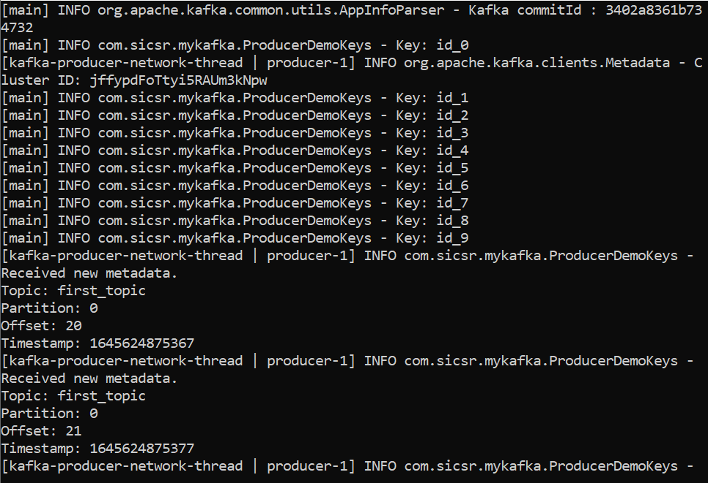
Output

Slide 33
Why do we use keys?
It guarantees that the same key always goes to the same partition
So, let us try it for new_topic_4, which has 3 partitions
Modified code: Next slide

Slide 34
ProducerDemoKeys2.java
package com.sicsr.mykafka;
import org.apache.kafka.clients.producer.*;
import org.apache.kafka.common.serialization.StringSerializer;
import org.slf4j.Logger;
import org.slf4j.LoggerFactory;
import java.util.Properties;
public class ProducerDemoKeys2 {
public static void main (String [] args) {
Logger logger = LoggerFactory.getLogger (ProducerDemoKeys2.class);
String bootstrapServers = "127.0.0.1:9092";
// create Producer properties
Properties properties = new Properties ();
properties.setProperty (ProducerConfig.BOOTSTRAP_SERVERS_CONFIG, bootstrapServers);
properties.setProperty (ProducerConfig.KEY_SERIALIZER_CLASS_CONFIG, StringSerializer.class.getName ());
properties.setProperty (ProducerConfig.VALUE_SERIALIZER_CLASS_CONFIG, StringSerializer.class.getName ());
// create the producer
KafkaProducer <String, String> producer = new KafkaProducer <String, String> (properties);
for (int i=0; i<10; i++) {
String topic = "new_topic_4";
String value = "Welcome to Kafka - " + Integer.toString (i);
String key = "id_" + Integer.toString (i);
// Create a producer record
ProducerRecord <String, String> record = new ProducerRecord <String, String> (topic, key, value);
// log the key
logger.info ("Key: " + key);
// send data
producer.send (record, new Callback () {
// Executes every time a message is successfully sent or an exception arises
public void onCompletion (RecordMetadata recordMetadata, Exception e) {
if (e == null) {
logger.info ("Received new metadata. \n" +
"Topic: " + recordMetadata.topic () + "\n" +
"Partition: " + recordMetadata.partition () + "\n" +
"Offset: " + recordMetadata.offset () + "\n" +
"Timestamp: " + recordMetadata.timestamp ());
}
else {
logger.error ("Error while producing ... ", e);
}
}
});
}
// flush data
producer.flush ();
producer.close ();
}
}

Slide 35
Analysis
Key id_0 is going to partition 1, id_1: partition 1, id_2: 2, id_3: 2, id_4: 2, id_5: 2, id_6: 2, id_7: 0, id_8: 0, id_9: 0
Rerun
Result should be the same
Same keys keep going to the same partition

Slide 36
Creating Kafka consumer (ConsumerDemo.java)
package com.sicsr.mykafka;
import org.apache.kafka.clients.consumer.ConsumerConfig;
import org.apache.kafka.clients.consumer.ConsumerRecords;
import org.apache.kafka.clients.consumer.ConsumerRecord;
import org.apache.kafka.clients.consumer.KafkaConsumer;
import org.apache.kafka.common.serialization.*;
import org.slf4j.Logger;
import org.slf4j.LoggerFactory;
import java.util.Properties;
import java.util.Arrays;
import java.time.Duration;
public class ConsumerDemo {
public static void main (String [] args) {
Logger logger = LoggerFactory.getLogger (ConsumerDemo.class.getName ());
String bootstrapServers = "127.0.0.1:9092";
String groupId = "my-fourth-application";
String topic = "new_topic_4";
// Set consumer configurations
Properties properties = new Properties ();
properties.setProperty (ConsumerConfig.BOOTSTRAP_SERVERS_CONFIG, bootstrapServers);
properties.setProperty (ConsumerConfig.KEY_DESERIALIZER_CLASS_CONFIG, StringDeserializer.class.getName ());
properties.setProperty (ConsumerConfig.VALUE_DESERIALIZER_CLASS_CONFIG, StringDeserializer.class.getName ());
properties.setProperty (ConsumerConfig.GROUP_ID_CONFIG, groupId);
properties.setProperty (ConsumerConfig.AUTO_OFFSET_RESET_CONFIG, "earliest");
// Create consumer
KafkaConsumer <String, String> consumer = new KafkaConsumer <String, String> (properties);
// Subscribe consumer to our topic(s)
consumer.subscribe (Arrays.asList (topic));
// Poll for new data
while (true) {
ConsumerRecords <String, String> records =
consumer.poll (Duration.ofMillis (100)); // poll after every 100 ms
for (ConsumerRecord <String, String> record : records) {
logger.info ("Key: " + record.key () + " Value: " + record.value ());
logger.info ("Partition: " + record.partition () + " Offset: " + record.offset ());
}
}
}
}

Slide 37
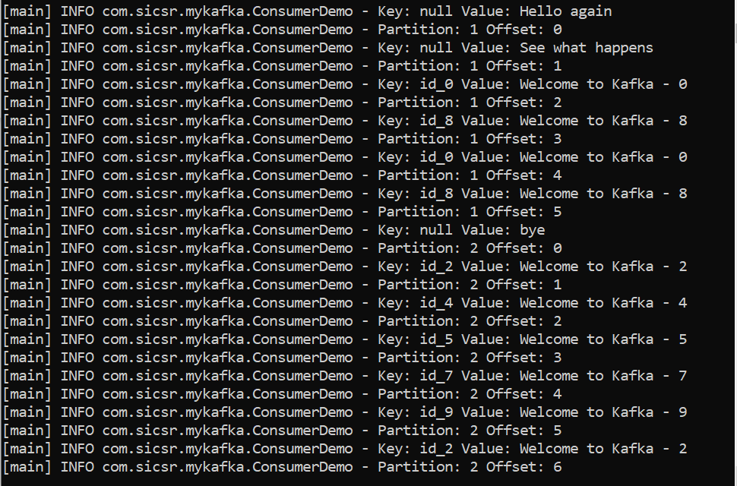
Consumer output

Slide 38
Getting a specific message: ConsumerDemoAssignSeek.java
package com.sicsr.mykafka;
import org.apache.kafka.clients.consumer.ConsumerConfig;
import org.apache.kafka.clients.consumer.ConsumerRecords;
import org.apache.kafka.clients.consumer.ConsumerRecord;
import org.apache.kafka.clients.consumer.KafkaConsumer;
import org.apache.kafka.common.TopicPartition;
import org.apache.kafka.common.serialization.*;
import org.slf4j.Logger;
import org.slf4j.LoggerFactory;
import java.util.Properties;
import java.util.Arrays;
import java.time.Duration;
public class ConsumerDemoAssignSeek {
public static void main (String [] args) {
Logger logger = LoggerFactory.getLogger (ConsumerDemo.class.getName ());
String bootstrapServers = "127.0.0.1:9092";
// String groupId = "my-fourth-application"; No need of a group id
String topic = "new_topic_4";
// Set consumer configurations
Properties properties = new Properties ();
properties.setProperty (ConsumerConfig.BOOTSTRAP_SERVERS_CONFIG, bootstrapServers);
properties.setProperty (ConsumerConfig.KEY_DESERIALIZER_CLASS_CONFIG, StringDeserializer.class.getName ());
properties.setProperty (ConsumerConfig.VALUE_DESERIALIZER_CLASS_CONFIG, StringDeserializer.class.getName ());
// properties.setProperty (ConsumerConfig.GROUP_ID_CONFIG, groupId);
properties.setProperty (ConsumerConfig.AUTO_OFFSET_RESET_CONFIG, "earliest");
// Create consumer
KafkaConsumer <String, String> consumer = new KafkaConsumer <String, String> (properties);
// No need: Subscribe consumer to our topic(s)
// consumer.subscribe (Arrays.asList (topic));
// Assign and seek are used to replay data or to fetch a specific message
// Assign
TopicPartition partitionToReadFrom = new TopicPartition (topic, 0); // 0 is partition number 0
long offsetToReadFrom = 5L;
consumer.assign (Arrays.asList (partitionToReadFrom));
// Seek
consumer.seek (partitionToReadFrom, offsetToReadFrom);
int numberOfMessagesToRead = 5;
boolean keepOnReading = true;
int numberOfMessagesReadSoFar = 0;
// Poll for new data
while (keepOnReading) {
ConsumerRecords <String, String> records =
consumer.poll (Duration.ofMillis (100)); // poll after every 100 ms
for (ConsumerRecord <String, String> record : records) {
numberOfMessagesReadSoFar++;
logger.info ("Key: " + record.key () + " Value: " + record.value ());
logger.info ("Partition: " + record.partition () + " Offset: " + record.offset ());
if (numberOfMessagesReadSoFar >= numberOfMessagesReadSoFar) {
keepOnReading = false;
break;
}
}
}
logger.info ("Exiting the application");
}
}

Slide 39
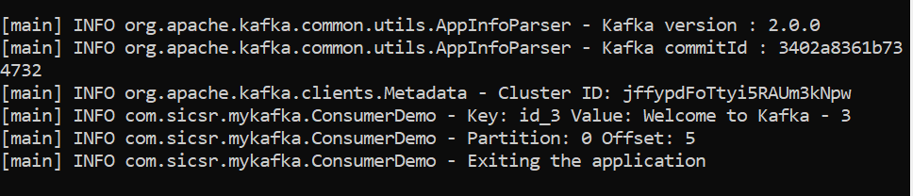
Sample output

